Slide 1
2023 Annual Meeting
Kingsgate Highlands 1 & 2 Homes Association
February 13, 2023
Start Time: 7:05pm

Slide 2
Agenda
Welcome and Introductions
Treasurer
Park/Pool
Reservations
Activities and Events
Kingsgate Cares Committee
Kingsgate Royals Swim Team
Q & A

Slide 3
Welcome and Introductions
President: Kyle Hutchison
Vice President: Brian Piper
Treasurer: Reed Wilson
Secretary: Sheila Morgan Quackenbush
Park/Pool Director: Keith Hodo
Activities Director: Gena Cook
Communications: Matt Hageman
Kingsgate Cares Committee Chairs: Rebecca Christiansen & Liz Stiger
Royals Swim Team Liaison: TBD

Slide 4
Treasurer – Overview
Balance Sheet Profit and Loss
2023 Fiscal Highlights
Up on every income category
Insurance costs continue to increase
Payroll costs increased due to increases in wages
A/R down 19%: 2 lots with mid to large back dues sold
Net income: ~$41k (does not include depreciation)

Slide 5
Treasurer – Lot Activity
Summary of Lot Activity
Year | Total Lots | Active Lots | Resigned Lots | Guest Members | Known Rentals | Total Assessed
2001 | 323 | 268 | 55 | 39 | No Data | 307
2002 | 323 | 270 | 53 | 45 | No Data | 315
2003 | 323 | 274 | 49 | 45 | No Data | 319
2004 | 323 | 275 | 48 | 45 | No Data | 320
2005 | 323 | 280 | 43 | 45 | No Data | 325
2006 | 323 | 284 | 39 | 45 | No Data | 329
2007 | 323 | 288 | 35 | 45 | No Data | 333
2008 | 323 | 288 | 35 | 45 | No Data | 333
2009 | 323 | 289 | 34 | 50 | No Data | 339
2010 | 323 | 291 | 32 | 47 | No Data | 338
2011 | 323 | 292 | 31 | 47 | No Data | 339
2012 | 323 | 292 | 31 | 41 | No Data | 333
2013 | 323 | 294 | 29 | 39 | No Data | 333
2014 | 323 | 294 | 29 | 37 | No Data | 331
2015 | 323 | 295 | 28 | 36 | No Data | 331
2016 | 323 | 295 | 28 | 34 | No Data | 329
2017 | 323 | 296 | 27 | 31 | No Data | 327
2018 | 323 | 297 | 26 | 28 | No Data | 325
2019 | 323 | 300 | 23 | 26 | No Data | 326
2020 | 323 | 302 | 21 | 21 | No Data | 323
2021 | 323 | 309 | 14 | 19 | No Data | 328
2022 | 323 | 311 | 12 | 17 | 19 | 328

Slide 6
Treasurer – Account Receivable

Slide 7
Treasurer – Reserve Study
Conducted Initial Reserve Study
Helps us plan for the next 30 years' worth of expenses to avoid needing special assessments to cover the costs
Takes into account all our assets and components requiring period maintenance and/or replacement
Recommendations:
$46k per year for minimum funding
$56k per year for full funding
2022 Reference: ~$41k excess

Slide 8
Treasurer – Annual Dues
Annual Dues
2023 dues
Homeowners: $700
Guest Members: $825
2024 dues (preliminary)
Homeowners: $700
Guest Members: $825
2025 dues (preliminary)
Homeowners: $750
Guest Members: $885
Dues will be sent out ~1-2 weeks after annual meeting
Due date is 5/15 for dues

Slide 9
Treasurer – 2023 Budget
2023 Budget
 | 2023 |  | 2022
Income | $251,975 |  | $240,500
Cost of Goods Sold | $204,200 |  | $105,516
Gross Profit | $47,775 |  | $134,984
Expenses | $104,150 |  | $93,295
Net Operating Income | -$56,375 |  | $41,689
Reserve Income | $56,375 |  | -$41,689
Total | $0 |  | $0

Slide 10
Park and Pool
Done in 2022
Replace Locker Room Heaters
New Signage in Park
New Canopies
Planned for 2023
Resurfacing Pool (April - $83k)
Tennis/Pickleball Court Improvements (Spring)
Address Drainage Problems in Playground Area (Spring Work Party)
Flagpole lighting (Spring)
Upcoming and Future Items
P1: Replace Pool Coping and Waterline Tiles (Budget $40k)
P2: Fence on North side of park (Parking Lot)
P3: Replace the retaining wall next to the tennis courts
P3: Replace the picnic shelter
P3: Replant the NE 137 planter
P3: Permanent Garbage Containers

Slide 11
10 Year Project Review
Repaired the 118th AVE retaining wall and sink hole under the sidewalk
Parking Lot replacement
Resurfaced the tennis courts
New pool boilers
New pool pump
New pool house paint (interior/exterior)
Lifeguard office refurbish
New fence surrounding the park
Replanting of the planter on 118th AVE
New pool filters
Shed expansion
150 yards of playground chips
New locker room heaters

Slide 12
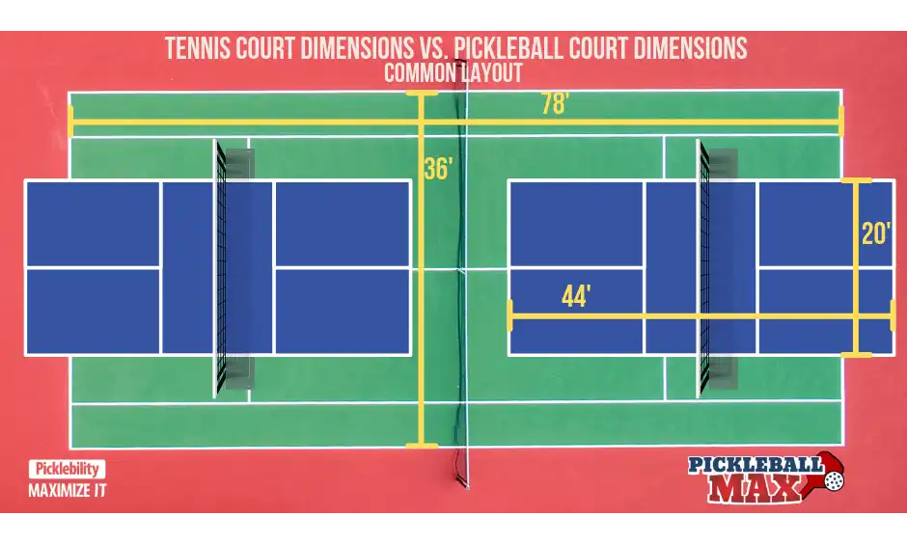
Tennis/Pickleball Court Improvements
Add two pickleball courts on West court
Two court lines painted, one per side (just lines, not background color)
Two rollaway nets provided
New signage for usage of courts and storage of pickleball nets
Updated Reservations Details
Court Lock Upgrade
Marina-style door handle
Hydraulic soft-close

Slide 13
Reservations
NEW online booking system for Tennis, Pickleball and Picnic/Field – link will be put on website
After initial approval - Make your own real-time reservations for these areas without going through the reservations person each time
To be an approved user, you need to create an account and have your dues paid for the current year. ONLY ONE ACCOUNT PER LOT
Dues notices are sent out in February. They are not due until May 15th. Reservations are allowed starting on May 1st 7 AM -- so PAY YOUR DUES EARLY if you want to make reservations right away!
Reservations person approves all accounts so please CREATE AN ACCOUNT EARLY and allow the reservations person enough time to approve prior to May 1st at 7 AM
NEW online form for Pool reservations – link will be put on website
Paper forms for reservations will still be available from the pool house but hoping to move to primarily making online reservation requests
NEW rules for Tennis, Pickleball and Picnic/Field – Details on next slide
Reminder: Reservation Season is May 1st – September 30th, the rest of the year is first-come-first serve

Slide 14
NEW Tennis & Pickleball Rules
•All courts are reservable throughout the day
•Old rule – only one court was reservable except specific times to allow for walk-in play (see next few rules for how we’re encompassing equal opportunity play in lieu of this change)
•Courts are reservable up to 2 weeks in advance
•Each lot can only make one court reservation, up to 90 minutes, per day
•Up to 4 court reservations per lot allowed per week (subject to change as usage/popularity indicates)
•The Kingsgate member reserving the court must be present at all times during the reservation
•i.e. No sharing/borrowing Member information to allow others to reserve “under your name”
•Members found in violation of this rule may have further reservation privileges revoked
•Tennis reservations – Always book the EAST tennis court first, if available
•The West tennis court will be dual purposed with Pickleball, so tennis players should only book the West court if the East court is already booked to allow for Pickleball reservations

Slide 15
Picnic Area/Field
•Reservations include both the picnic area and the ball field
•No tennis or pickleball courts are included, they must be reserved separately
•Reservations can be made for the whole season beginning on May 1st, 7 AM
•Each lot can only make one Picnic Area/Field reservation, up to 6 hours, per day
•Currently no limit on how many reservations per season (subject to change as usage/popularity indicates)
•No fee/deposit to reserve, however there will be a $50 fine charged to the reserving lot if clean up is required after your party. Clean-up checklist available in the pool house and can be signed off by a lifeguard to ensure that you are not charged a fine
Pool
There is a new, online form that will be available on our website
The reservations person will still process each individual request
Payment structure remains the same, however credit card payments will now be accepted
Reservations can be made for the whole season beginning on May 1st, 7 AM

Slide 16
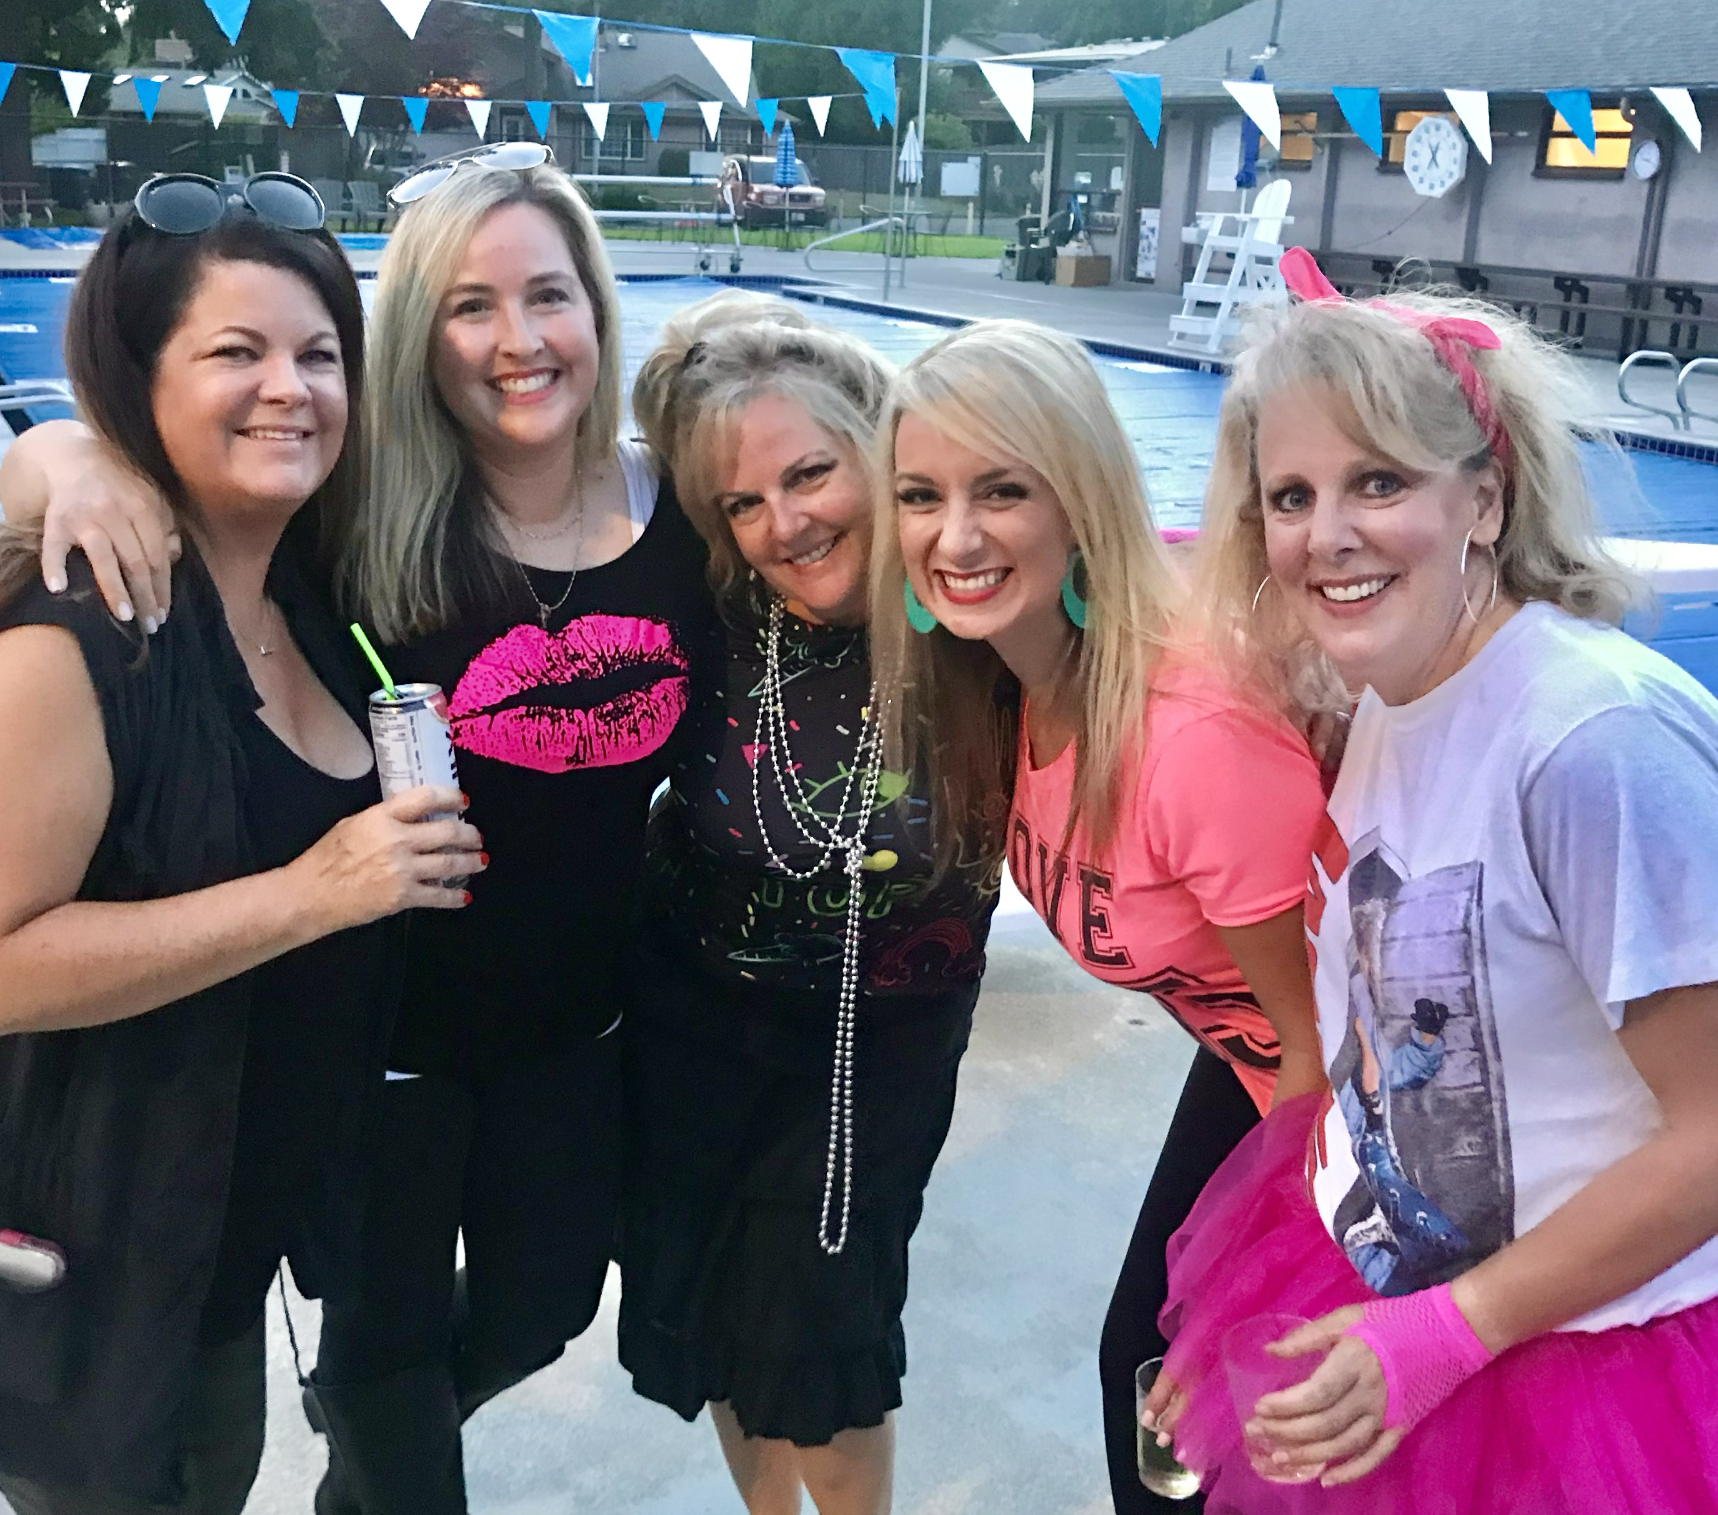
ACTIVITIES / EVENTS
Easter Egg Hunts
April 8, 2023
Kids – 10:00 a.m. SHARP
Teens – Dusk (~8 p.m.)
Pool Opening
Sat. May 27, 2023
Deck Party
July TBD
Kingsgate Days
Aug TBD
Movie in the Park
Fri, Aug 18, 2023
Volunteers are needed to sustain traditions. This is a time to come together and build community. Please reach out if you would like to join the committee.
kg12activities@gmail.com

Slide 17
Kingsgate Cares
WHAT WE DO:
1. Welcome new homeowners to the neighborhood.
2. Congratulate families on new additions.
3. Help care for the sick.
4. Comfort those who are grieving.
5. Give rides.
JOIN US!
Drop in the 2nd Tuesday of each month for a light lunch, connect with neighbors and help address neighborhood concerns
12:00pm (noon) @ Liz Stiger's House
13617 117th Ave NE
Email us to get involved!
Working together to build a stronger sense of community one kind deed at a time.
KingsgateCares@gmail.com

Slide 18
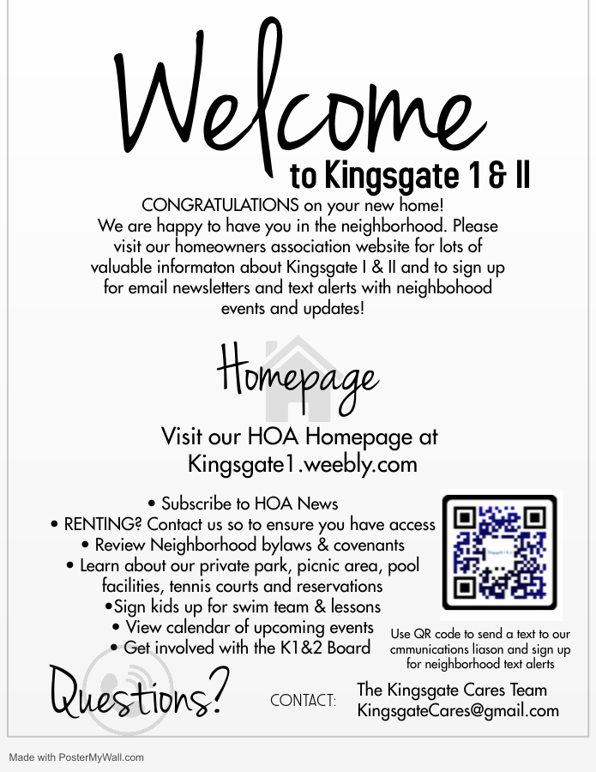
Welcome information delivered to new neighbors with a homemade treat
2022-2023 Year in Review
30 neighbors participated in KC lunch events & KC service opportunities
12 new homeowners/renters welcomed (or attempted delivery)
2 meal trains set up, 16 meals delivered to families with new babies and widows
8 trays of cookies delivered to show gratitude
3 condolences offered
1 gutter cleaning
1 ride to a doctor appointment
If you or a neighbor need extra care, please email: KingsgateCares@gmail.com
THANK YOU FOR SHOWING UP FOR ONE ANOTHER!

Slide 19
Kingsgate Royals Swim Team
Swim Team is looking for board members. Available positions are:
President
Vice President
Treasurer
If positions are not filled, the season will not occur.
Registration for HOA members opens early April
First swim practice: Likely May 22, 2023
Website: https://kingsgateroyals.wordpress.com/
Reach out to the Registrar for information on the season or to find out more about a board position.
Julie Hageman (Registrar.kingsgateroyals@gmail.com)

Slide 20
Q & A

